Slide 1
LANGUAGE MODELING LSTM vs. Transformer
Attention Is All You Need
Ashish Vaswani, Google Brain, avaswani@google.com | Llion Jones, Google Research, llion@google.com
Noam Shazeer, Google Brain, noam@google.com | Aidan N. Gomez y, University of Toronto, aidan@cs.toronto.edu
Niki Parmar, Google Research, nikip@google.com | Łukasz Kaiser, Google Brain, lukaszkaiser@google.com
Jakob Uszkoreit, Google Research, usz@google.com | Illia Polosukhin, illia.polosukhin@gmail.com

Slide 2
Overview
Modeling sequences
Encoding – mapping a sequence into a vector
Decoding – mapping a vector to a sequence
What’s in the box
RNN
LSTM
Limitations
Transformers
Architecture
Comparison to LSTM

Slide 3
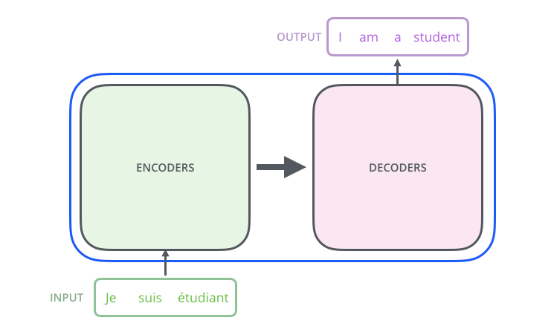
Sequence modeling
Use translation as an example
Looks like a simple supervised problem
Dataset of input sentences and expected output sentences
But
Context is important
Sentences are not fixed length
Goals
Capture history into a vector format (encoding)
Map the encoded vector to a result (decoding)
Model
Contains both encoders and decoders
Train both at the same time

Slide 4
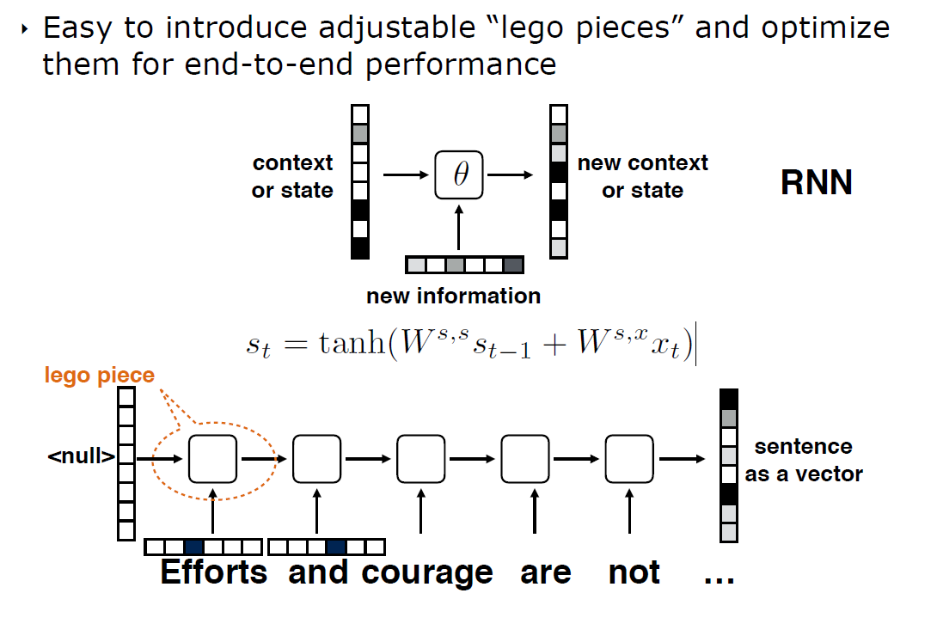
Encoding Sentences
Example shows the RN unfolded
Usually, recursion is done in place

Slide 5
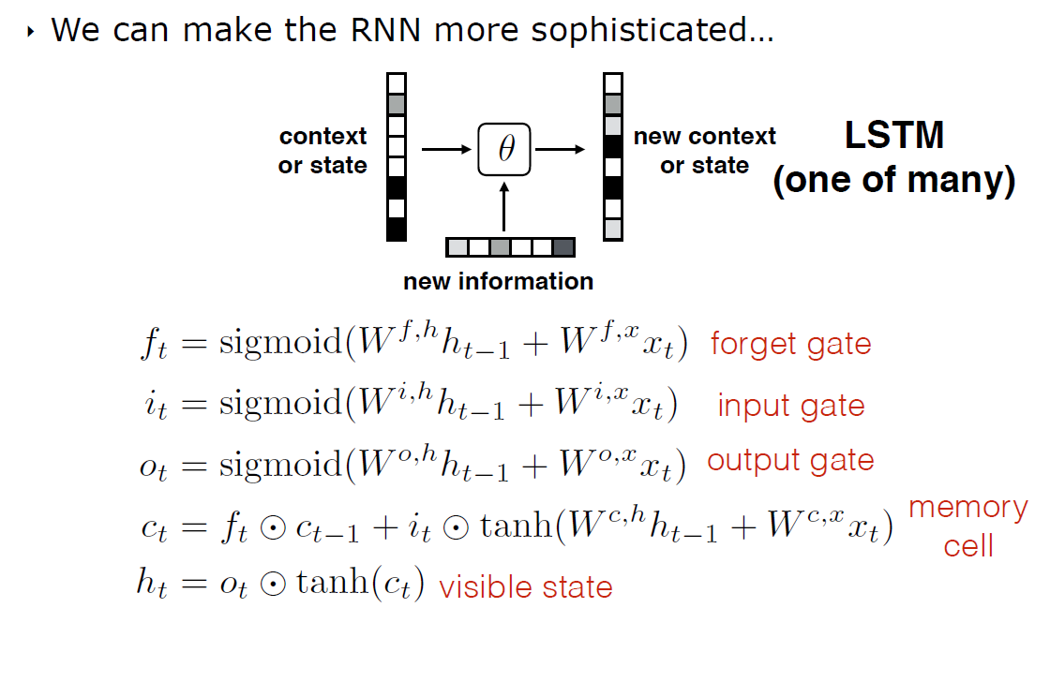
Long short-term memory – LSTM
Adds memory cell
Add controls on which items to keep
Inputs
Previous states
Outputs
Vs. RNN
Addition of memory cell allows capturing longer sequences
Many more parameters requires more input data and longer training
ELMo
"Deep contextualized word representations” by Peters et al.

Slide 6
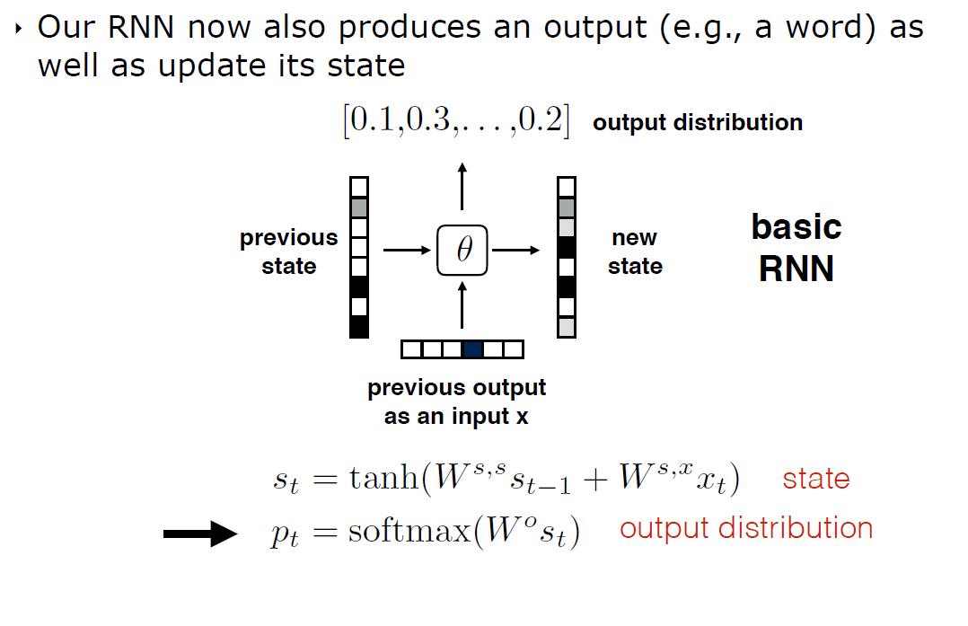
Decoding
Output is a list of probabilities, one for each word in the target corpus

Slide 7
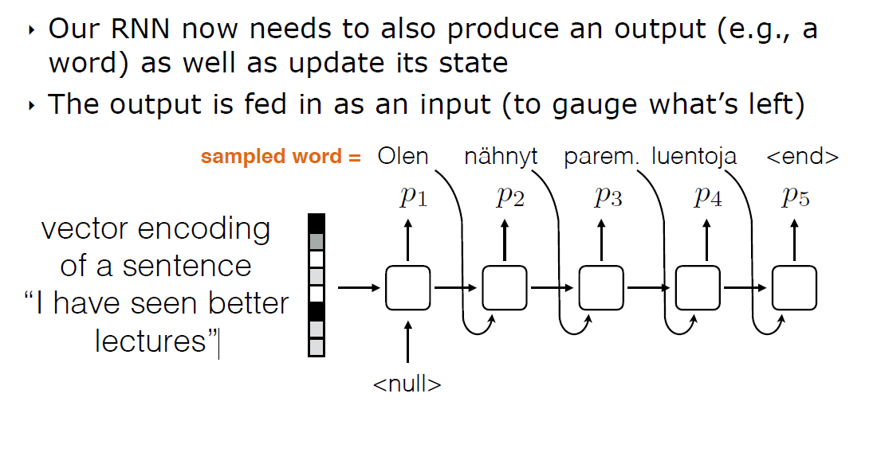
Decoding

Slide 8
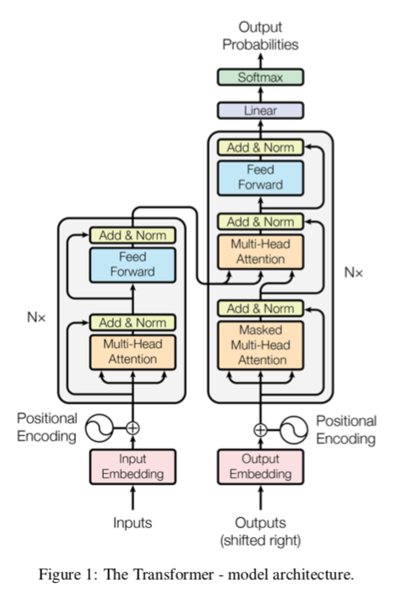
Transformer
Goal
Improve long dependencies
Remove recursion
Key characteristics
Non sequential: sentences are processed as a whole rather than word by word.
Self Attention: this is the newly introduced 'unit' used to compute similarity scores between words in a sentence.
Positional embeddings: another innovation introduced to replace recurrence. The idea is to use fixed or learned weights which encode information related to a specific position of a token in a sentence.
Encoded sentence (hidden state)
Decoder
Encoder

Slide 9
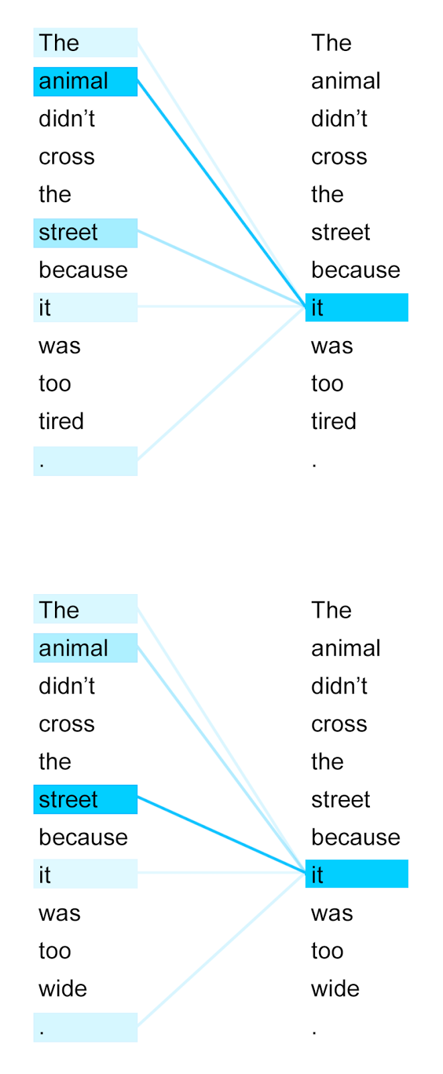
Attention
Method to identify which words in the sentence has most impact on each words meaning
For the two similar sentences to the right, the color in the first column indicates which words had higher similarity scores to the uses of “it”

Slide 10
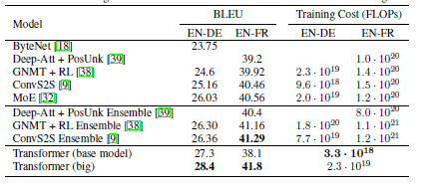
Summary
In the paper, the authors were primarily motivated to speed up training
Increase parallelism by removing recurrence
Additionally, they were able to increase translation scores
Allowing longer span of word influence through attention
This technology was key to unlocking recent powerful language models
BERT
GPT-2
GPT-3
Bilingual Evaluation Understudy Score
The Bilingual Evaluation Understudy Score, or BLEU for short, is a metric for evaluating a generated sentence to a reference sentence.

